Slide 1

IILM UNIVERSITY, GREATER NOIDA
NetSage AI
AI-Assisted Network Fault Diagnosis with Enforced Human Review
Cisco – AICTE Virtual Internship Program 2026 • Problem Statement 2: Applied AI + Network Troubleshooting
STUDENT
Samarth Mehrotra
SESSION
2024 – 2028
ENROLMENT NO.
2410030934
ORGANIZATION
Cisco Networking Academy (AICTE VIP 2026)
PROGRAMME & SEMESTER
B.Tech CSE • Semester 5
DOMAIN
Applied AI • Modern AI track
Notes:
Title slide. Introduce yourself, IILM University, the Cisco–AICTE Virtual Internship, and the project: NetSage AI — an AI network-troubleshooting assistant with human review enforced in code.

Slide 2
01
The Problem & Objective
Diagnosis is slow and manual
An engineer reads pages of show-command output and infers the fault by hand.
OBJECTIVE
Use an LLM’s reasoning to accelerate fault diagnosis — while guaranteeing that a human validates every fix before it can be applied.
LLMs can help — but they hallucinate
They invent evidence or reach a confident, wrong conclusion.
So an unsupervised AI troubleshooter is unsafe
It cannot be trusted to act on a live network by itself.
The reasoning of AI, with the accountability of human review.
Notes:
The problem: manual diagnosis is slow; LLMs are fast but hallucinate, so an unsupervised AI troubleshooter is unsafe. Objective: keep the AI’s reasoning, but require human sign-off on every fix.

Slide 3
02
What NetSage AI Does
INPUT
NETSAGE AI
STRUCTURED DIAGNOSIS
A plain-language fault report + the show-command output from the affected devices.
Analyzes the transcript, cross-checks two independent layers, and explains the mechanism.
Root cause • OSI layer • verbatim evidence • next command • fix steps.
Then it STOPS.
No fix it proposes can be applied until a human reviewer approves it — and that gate is enforced in code, not written in a policy document. There is no override flag.
Notes:
Input is a fault report plus show output; output is a structured diagnosis. The key point is the red panel: it then stops and refuses to apply anything until a human approves — enforced in code.

Slide 4
03
How It Works — Four Stages
1
2
3
4
Rule Checker
AI Diagnosis
Human Review
Apply-Gate + Dashboard
34 deterministic checks in pure Python. Every finding quotes the exact transcript line — it cannot hallucinate.
Claude reasons across multiple show outputs. Output is schema-validated and every evidence line is checked verbatim.
Presents transcript → checker → AI, in that order. The reviewer accepts, edits, or rejects.
The apply step refuses fixes unless approved. A pandas / matplotlib dashboard summarises coverage.
The two automated layers are designed to fail in opposite directions.
Notes:
Four stages: deterministic rule checker, AI diagnosis, ordered human review, and an apply-gate plus dashboard. The design point: the two automated layers fail in opposite ways.

Slide 5
04
Two Layers, Failing in Opposite Directions
RULE CHECKER
AI DIAGNOSIS
✓ Cannot hallucinate — every finding carries its verbatim trigger line.
✓ Can reason across many show outputs and explain the mechanism in prose a student can learn from.
VS
✗ Cannot reason about intent — it misses NS-002, a port in the wrong VLAN where every config line is well-formed.
✗ Can invent — on NS-021 it imagined powered-off hosts to explain a reachability boundary at .63.
Where they disagree, one of them is wrong — a far more useful thing to hand a reviewer than a single confident answer.
Notes:
The rule checker can’t hallucinate but can’t reason about intent; the AI can reason but can invent. Running both and showing the reviewer where they disagree is the core idea.

Slide 6
05
Human Oversight — Enforced in Code, Not Policy
Evidence is verified against the transcript before a human sees anything.
$ python src/netsage.py apply --case NS-031
!! REFUSED — no fix steps will be emitted for NS-031.
NS-031 was REJECTED on review by Samarth Mehrotra.
The AI diagnosis was found incorrect, so its fix
steps must not be applied.
Reviewer note: 'State Assoc' means the WPA2 four-way
handshake already completed — so the link-layer fix
cannot be right.
The reviewer reads the raw evidence before the AI’s conclusion — by design.
No override flag. No code path from a diagnosis to a fix that skips the gate.
Notes:
This is the core safety mechanism. Running apply on a rejected case is refused in code. Evidence is verified first, the reviewer reads evidence before the AI’s answer, and there is no way to bypass the gate.

Slide 7
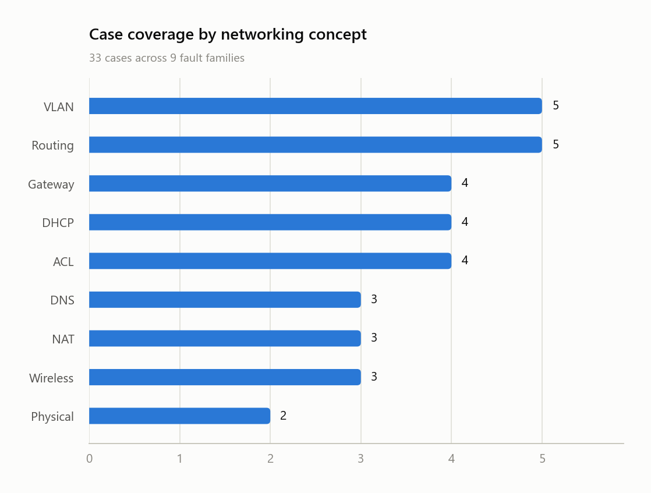
06
Results — Reproducible from the CLI
33
Troubleshooting cases · 9 fault families
34
Deterministic checks · 97% catch rate
33 / 33
AI diagnoses schema-valid
65
Automated tests passing
Coverage & honesty
9 fault families across OSI layers 1–4 and 7.
Brief required 30 cases — 33 delivered.
Brief required 5 corrections — 12 documented.
Every figure is produced by code in the submitted project and reproducible from one command.
Notes:
Headline numbers, all reproducible from the CLI: 33 cases, 34 checks at a 97% catch rate, 33/33 schema-valid AI outputs, 65 tests. The chart shows coverage across nine fault families.

Slide 8
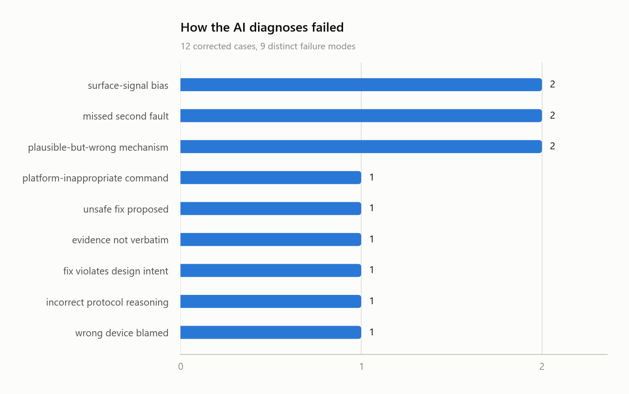
07
The Result Worth Being Honest About
63.6%
AI–human agreement (21 accepted · 7 edited · 5 rejected)
The 12 non-accepted diagnoses are committed as-is, each documented with its failure mode — not regenerated until the model agreed.
Reported honestly
This is a demonstration corpus, not a blind benchmark — the case library and the recorded AI responses were produced in the same session. A ‑‑provider anthropic path exists for a genuinely blind re-run on a fresh case set.
Notes:
Be upfront here: 63.6% agreement, 12 wrong answers kept as-is. Crucially, this is a demonstration corpus, not a blind benchmark, because the cases and AI responses came from the same session. A blind re-run path exists.

Slide 9
08
Responsible AI in Practice
Human oversight here is mechanical, not advisory.
1
Verify first
2
Evidence before answer
3
The gate blocks bad fixes
Evidence is checked against the transcript before any human sees it.
The reviewer reads the raw evidence before the AI’s conclusion — by design.
Unreviewed or rejected diagnoses can never emit fix steps.
12
corrections logged — each with its failure-mode category and the prompt, checker, or procedure change it drove. Most were not fixable by prompting the model more nicely, which is itself a finding.
Notes:
Oversight is mechanical: verify evidence first, show evidence before the answer, and gate every fix. All 12 corrections are logged with a failure mode and the change each drove.

Slide 10
09
Technology & Testing
Python 3.13
pandas + matplotlib
Jinja2
Pure Python — no heavy framework, no cloud stack to stand up.
Dashboard charts, with a palette validated for colour-blind safety.
A single, self-contained HTML dashboard report.
Claude API
Offline by default
65 pytest tests
Called directly over HTTPS via requests — no SDK dependency.
A recorded provider replays committed responses — a demo can’t fail on connectivity.
Including named regression tests for real parser bugs found in development.
Notes:
Deliberately small, standard toolchain: pure Python, pandas/matplotlib/Jinja2, the Claude API over plain HTTPS, offline-by-default replay, and 65 tests including regression tests.

Slide 11
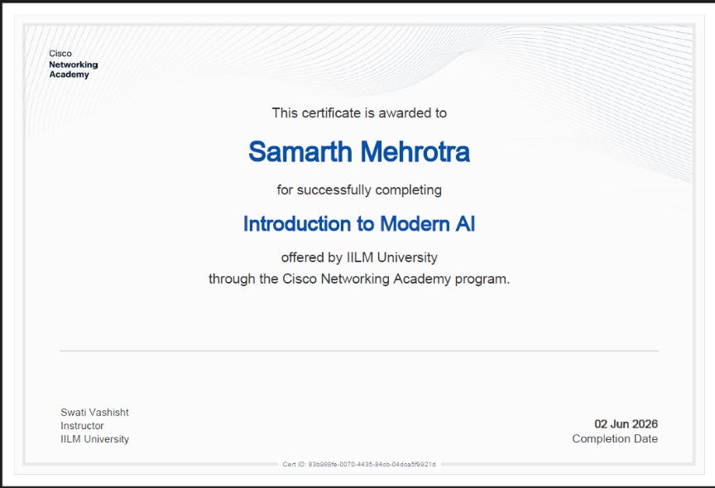
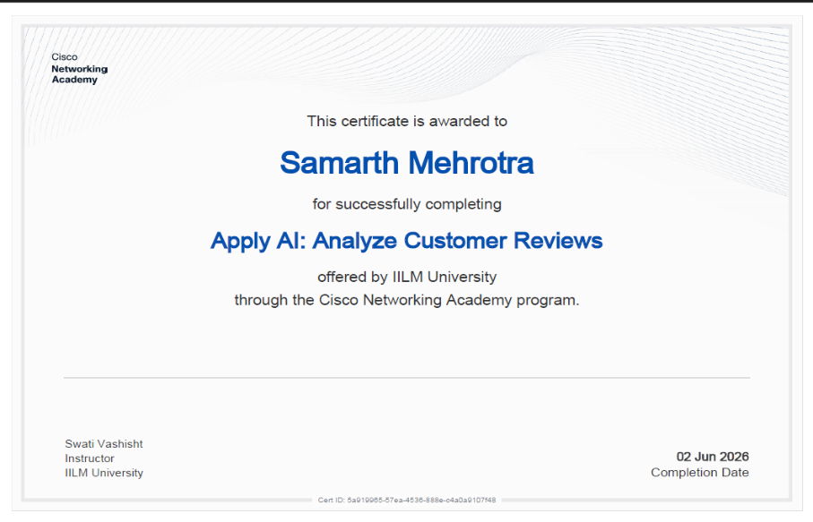
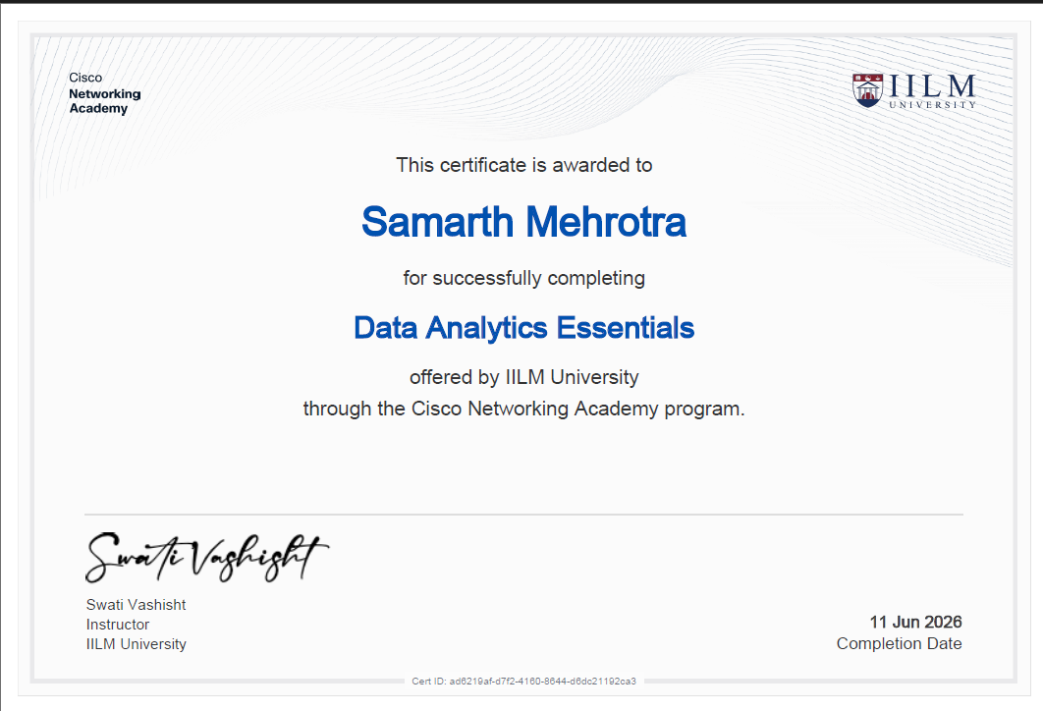
10
Certifications Completed
All offered by IILM University through the Cisco Networking Academy program.
Introduction to Modern AI
Completed 02 Jun 2026
Apply AI: Analyze Customer Reviews
Completed 02 Jun 2026
Data Analytics Essentials
Completed 11 Jun 2026
The internship’s main course is Modern AI — this is an AI-domain submission, so no Packet Tracer (.pkt) file is required.
Notes:
Three completed AI-track certificates, all through the Cisco Networking Academy program at IILM University. Because the track is Modern AI, this is an AI-domain submission and no Packet Tracer file is required.

Slide 12
Let the model reason — but verify its evidence automatically, and require a human to approve every action.
NetSage AI’s most important behaviour is the one thing it refuses to do.
Thank You
Samarth Mehrotra • 2410030934 • B.Tech CSE, Semester 5 • IILM University
Notes:
Close on the thesis: reasoning plus automatic evidence checks plus mandatory human approval. Thank the panel and invite questions.

